Slide 1
Refactoring the addToCart Method

Slide 2
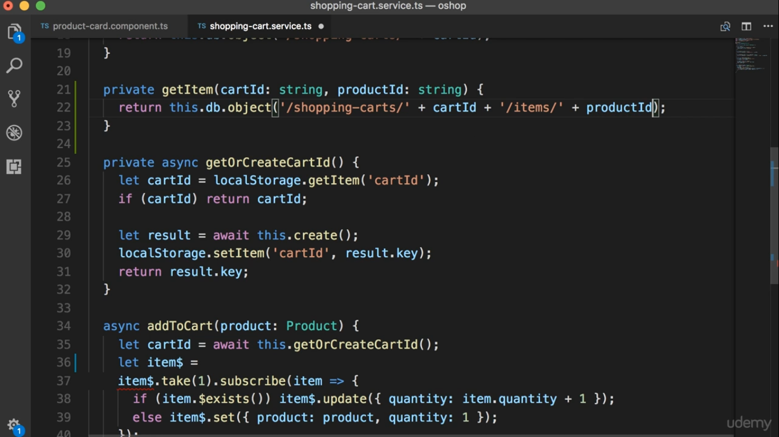

Slide 3
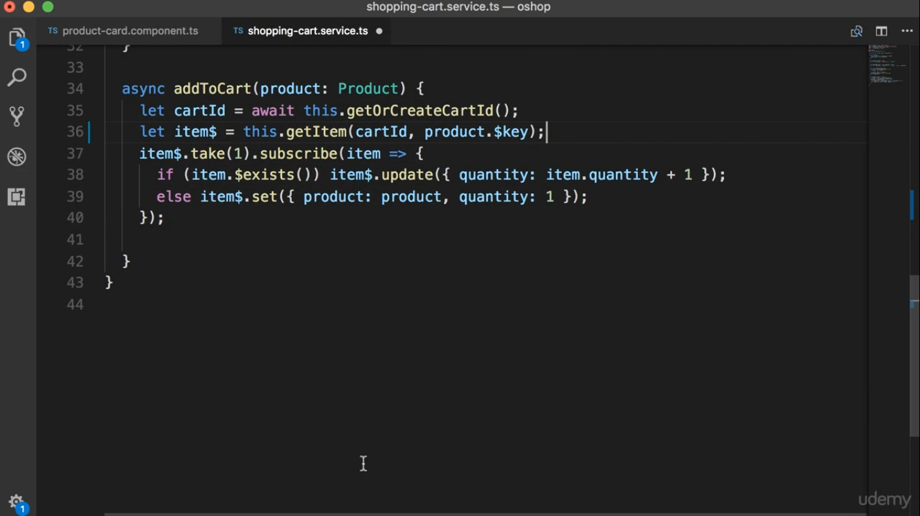

Slide 4
